Slide 1
Mask-RCNN and Implementation
Week2 Hua Jiang

Slide 2
Models and Relative Paper
Instance segmentation of apple flowers using the improved mask ReCNN model
WheatSpikeNet: an improved wheat spike segmentation model for accurate estimation from field imaging
Mask R-CNN

Slide 3
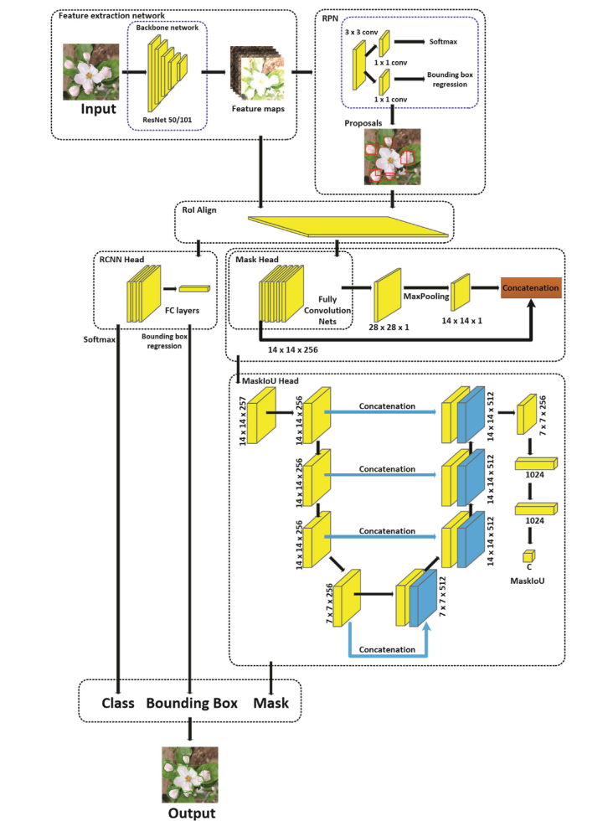
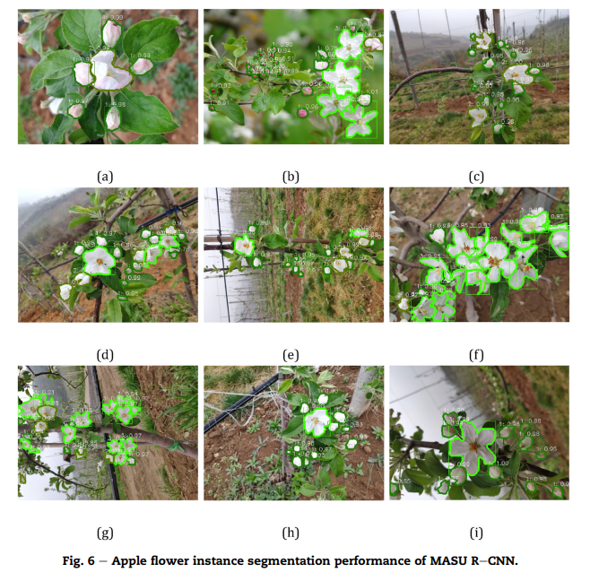
MasU-RCNN
An advanced model based on Mask-Scoring RCNN
U-Net can also be set there
U-Net helps with combining the graphical feature and position info

Slide 4
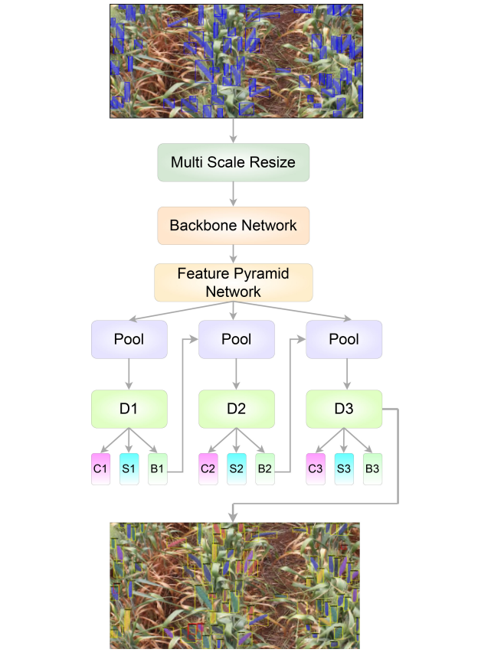
Improved Cascade Mask RCNN
Plus Deformable Convolution Network
Generic RoI Extractor on RPN
Plus Balanced Feature Pyramid
Side Aware Boundary Localization on Bounding box calculation
Cascade structure

Slide 5
In future
Unseen Object Amodal Instance Segmentation via Hierarchical Occlusion Modeling
Robotic pick-and-place of novel objects in clutter with multi-affordance grasping and cross-domain image matching

Slide 6
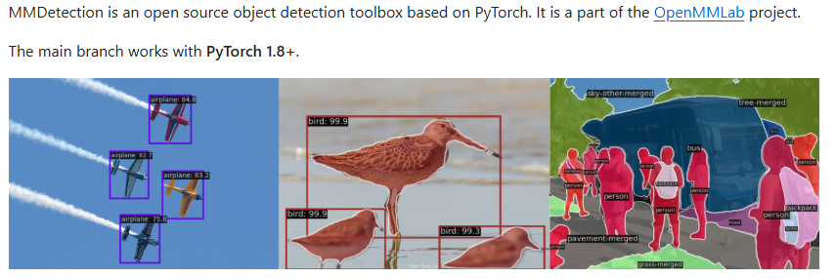
Implementation-MMDetection

Slide 7
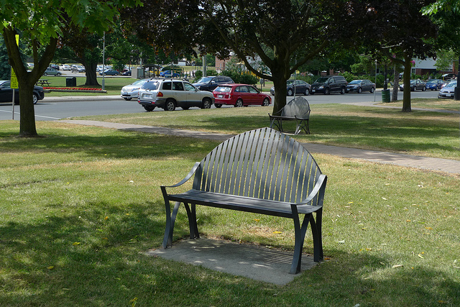
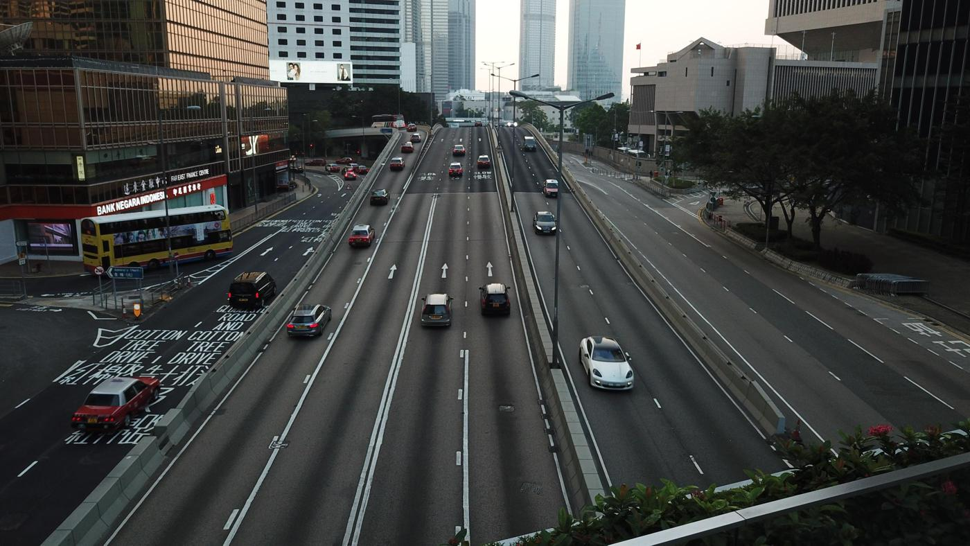
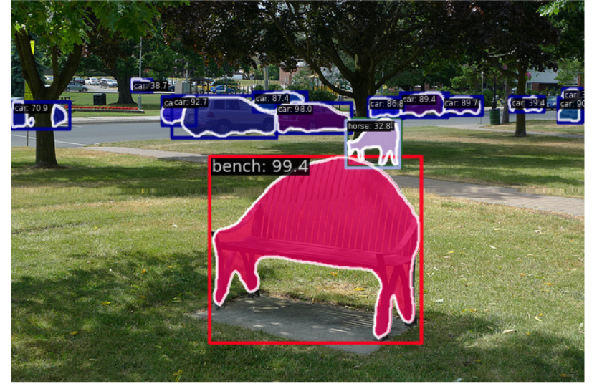
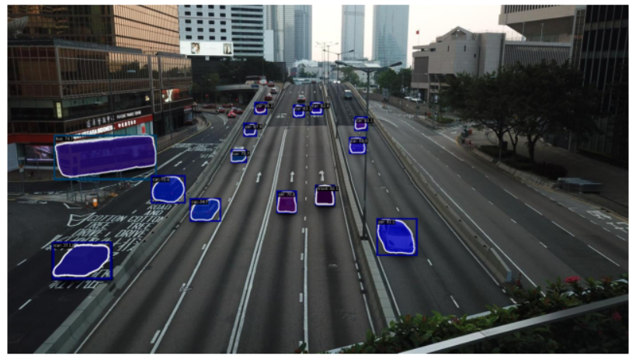
Mask RCNN and Mask Scoring RCNN
Based on a well-trained configuration
Problem: Extremly slow on this laptop’s gpu training the model with new dataset
Potential Solution: Lower Resolution, small batch size, small number of workers, AmpOptimWrapper instead of optim_wrapper

Slide 8
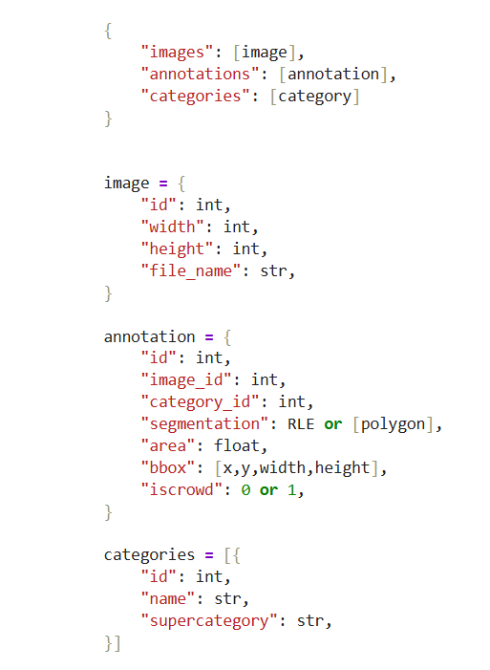
In future
Data annotation (must in COCO format)
Train with new dataset

